Slide 1
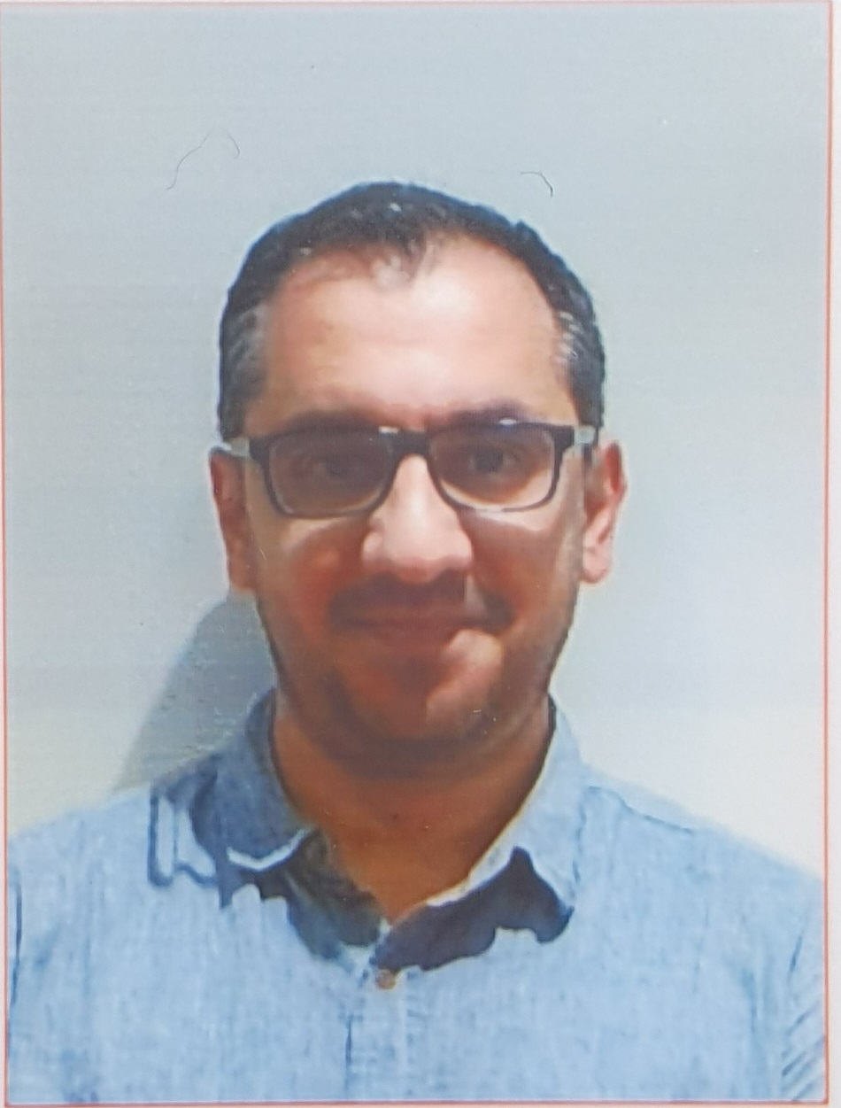
Introduction to Software Engineering (ISE102) Tutorial Week 5

Slide 2
Week 5 Outline
Have you formed your group?
Preparation for Group Assignment – Part 1: Analysis and Design
Class Diagram Practice
From UML Diagram to Code: Library Example (Java)
From UML Diagram to Code: Library Example (Python)
Activity 1 — Show the current count when limit blocks borrowing
Activity 2 — Show total borrowed after a successful borrow
Activity 3 — Show remaining count after a successful return
Activity 4 — Track how many times a book has ever been borrowed

Slide 3
Week 5 Outline
Activity 5 — Show who already has the book
Activity 6 — Show remaining slots after a successful borrow
Activity 7 — When returning a book you don’t have, show who actually has it
Activity 8 — Simple email sanity check on member creation
Activity 9 — Tidy book titles on creation
Activity 10 — Warn on duplicate ISBN when adding to the library

Slide 4
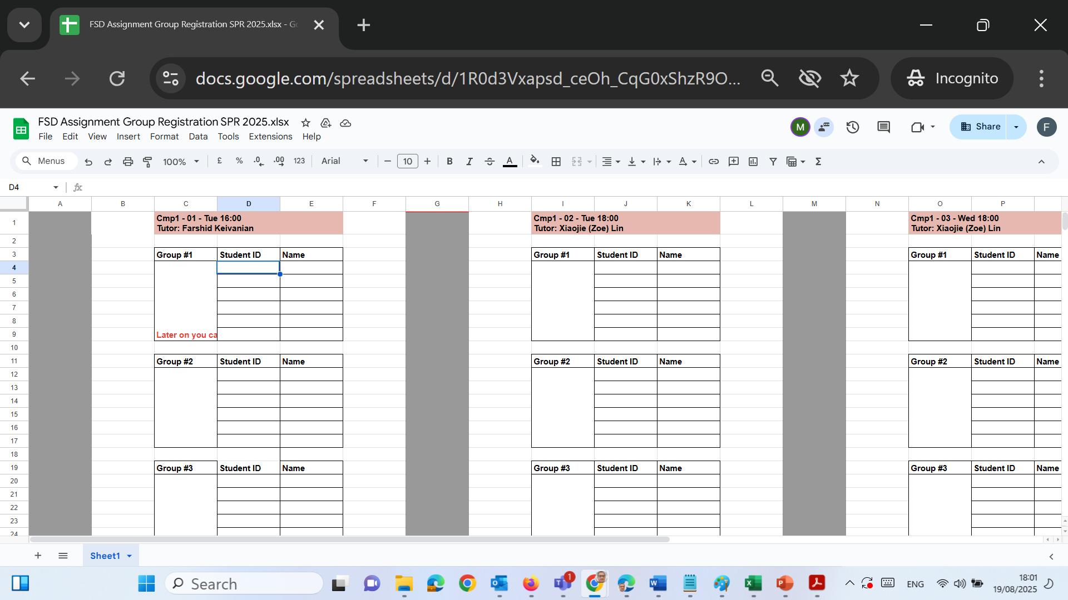
Have you formed your group?
Please send me an email listing your group members and kindly CC all members of your group in the same email. This will help us keep everything clear and ensure everyone is informed. Farshid.Keivanian@uts.edu.au
Once I receive your email, I will fill in the online sheet with your group details and share it with the Unit Coordinator.

Slide 5
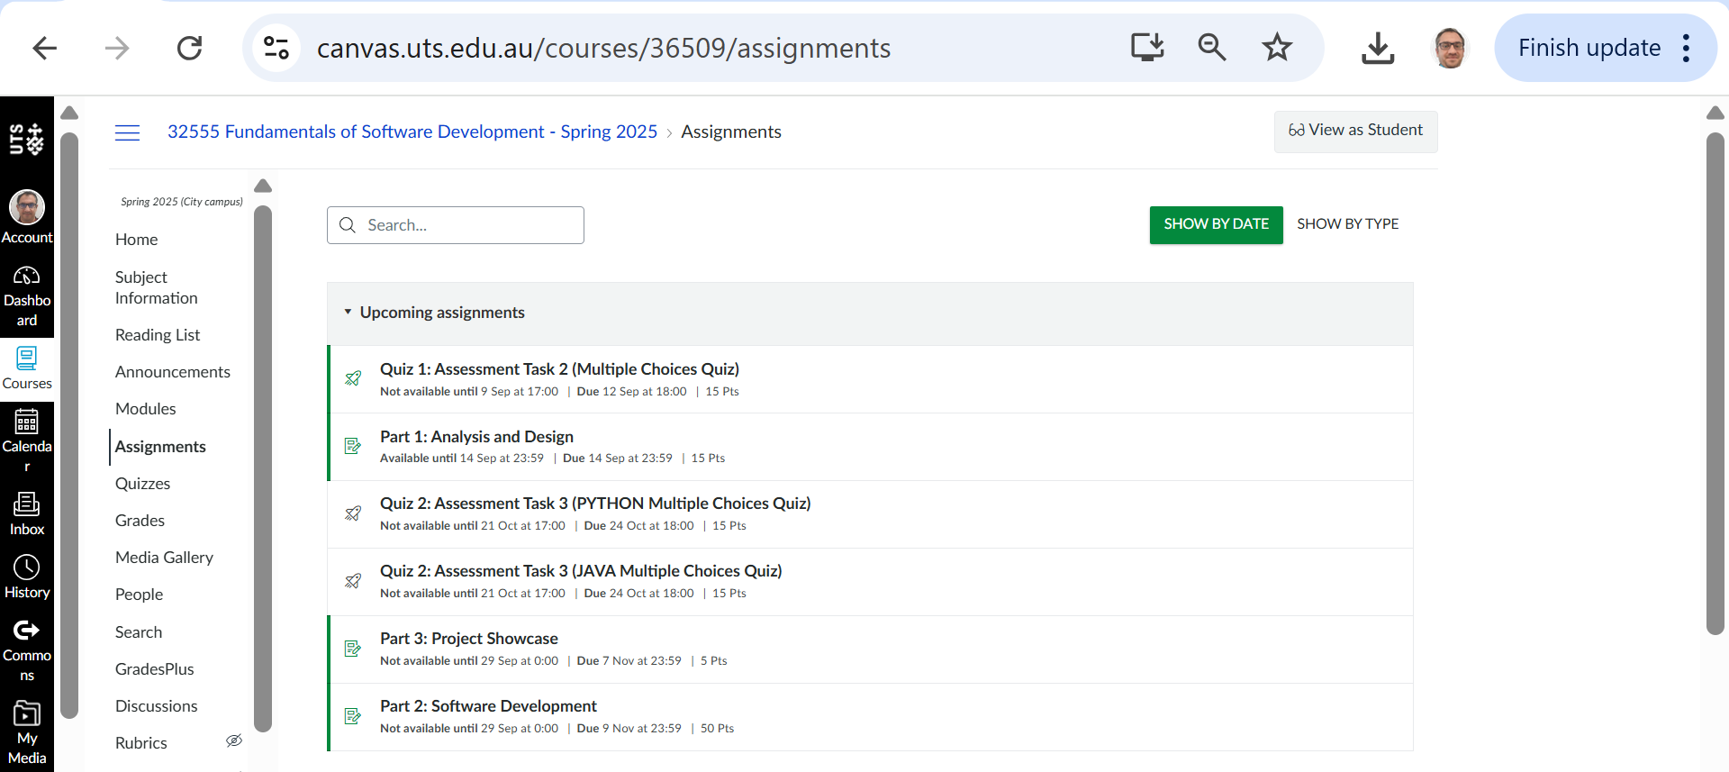
Preparation for Group Assignment – Part 1: Analysis and Design

Slide 6
Preparation for Group Assignment – Part 1: Analysis and Design
General admin (read first)
Groups: 3–4 students. Self-assign by end of Week 5 (Canvas group tool or tell your tutor in labs).
Submission: One group file for Assessment 1 – Part 1 (PDF or DOCX) by Sunday of Week 7.

Slide 7
Preparation for Group Assignment – Part 1: Analysis and Design
Filename: group<group-number>-Cmp1<lab-number>.<pdf|docx> (e.g., group07-Cmp103.pdf).
Peer rating (Sparkplus): 8 Sep 2025, 12:00 AM – 14 Sep 2025, 11:55 PM.
Scope: Part 1 is analysis & design only (no code required). Part 2 is implementation; Part 3 is the showcase.

Slide 8
Preparation for Group Assignment – Part 1: Analysis and Design
Step-by-Step Tasks
Step 1: Define the scope
Actors: Student, Admin, System.
Students can: Register, log in, enrol in max 4 subjects, drop subject, view enrolments, change password.
Admins can: View students, group by grade, PASS/FAIL lists, delete student, clear data.
System must: Generate IDs, save/load from students.data, auto-assign marks + grades.
Not included: GUI (that’s Part 2), multi-semester enrolments.

Slide 9
Preparation for Group Assignment – Part 1: Analysis and Design
Example of scope in practice
A student named Leila registers with email + password → system gives her ID 000123. She logs in, enrols in 2 subjects. Each subject gets an ID (e.g., 005, 018) with marks (72 → C, 89 → HD). An admin later views all students and sees Leila grouped under PASS.
That little story makes it obvious what is in scope (IDs, enrolment, PASS/FAIL) and what is not (choosing subject names, GUI).

Slide 10
Preparation for Group Assignment – Part 1: Analysis and Design
Step 2: Write user stories (with IDs)
Format: As a [user], I want to [do something] so that [result happens].
Use 3-digit IDs (group features: 1xx login, 2xx registration, 3xx enrolment…).
Example:
100 – As a student, I want to log in so that I can access my enrolment list.
200 – As a student, I want to register with email/password so that I get a student ID.

Slide 11
Preparation for Group Assignment – Part 1: Analysis and Design
Then make a table (backlog):
ID | User | Action | Result | Function
100 | Student | Enter email + password | Access student menu | login()
200 | Student | Register account | New ID created (000123) | registerStudent()
300 | Student | Enrol in subject | Subject added with ID+grade | enrolSubject()
700 | Admin | View all students | List shown from file | adminListAll()

Slide 12
Preparation for Group Assignment – Part 1: Analysis and Design
Step 3: Draw a use case diagram
Show actors → connect to system use cases (ovals).
Add relationships:
include: always part of process (e.g., “Validate Email” included in “Register”).
extend: only sometimes (e.g., “Show error” extends from “Login”).

Slide 13
Preparation for Group Assignment – Part 1: Analysis and Design
Step 4: Draw a class diagram
Classes: Student, Subject, AuthService, DataStore, Admin.
Show attributes + methods.

Slide 14
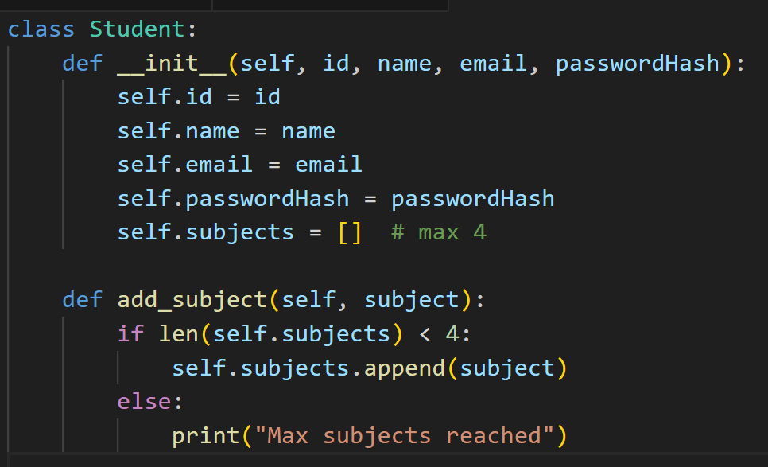
Preparation for Group Assignment – Part 1: Analysis and Design
No coding is required in Part 1.
This Python example is just an illustrative example to help you think about what attributes (like id, name, email) and methods (like add_subject()) belong in each class.
JavaFX students can use similar class structure.

Slide 15
Preparation for Group Assignment – Part 1: Analysis and Design
For submission, students must present the UML class diagram (boxes with attributes + methods, plus relationships between classes).
They can draw it using:
draw.io (diagrams.net) – free, easy, works in browser.
Visio – good if they already have it.
PlantUML – for those who like writing code-based diagrams.

Slide 16
Preparation for Group Assignment – Part 1: Analysis and Design
For All Steps
Students can use drawing tools (draw.io, Lucidchart, Visio, or even Word’s SmartArt/shapes) for:
Step 2: Backlog → table in Word/Excel (not a diagram).
Step 3: Use case diagram → draw.io or PlantUML.
Step 4: Class diagram → draw.io, Visio, or PlantUML.
Students do not need to write code for diagrams. Coding only starts in Part 2.

Slide 17
Preparation for Group Assignment – Part 1: Analysis and Design
Step 5: Write System Rules
Email must end with @university.com.
Password: Uppercase first, ≥5 letters, then ≥3 digits (e.g., TigerPass123).
Student IDs: 6 digits (zero-padded). Example: 000045.
Subject IDs: 3 digits (zero-padded). Example: 007.
Grades:
Z (<50), P (50–64), C (65–74), D (75–84), HD (≥85).

Slide 18
Preparation for Group Assignment – Part 1: Analysis and Design
Step 6 – Design the Data File
Part 1 is analysis & design only. Students do not need to actually create or code a JSON/CSV file in VS Code.
Students don’t need to code or save a .json file in VS Code. They just need to show an example format (like above) inside their report, so that later in Part 2 (implementation) they know what structure to use.

Slide 19
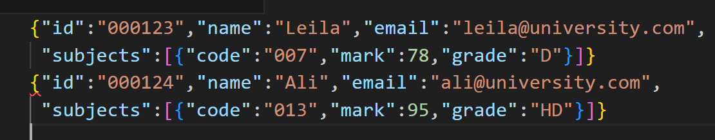
Preparation for Group Assignment – Part 1: Analysis and Design
Example they can include in their report: Sample JSON format

Slide 20
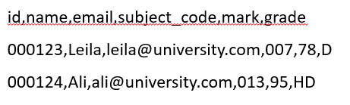
Preparation for Group Assignment – Part 1: Analysis and Design
Alternative snippet (CSV format)

Slide 21
Preparation for Group Assignment – Part 1: Analysis and Design
Step 7: Check quality
Does every requirement appear in your user stories → use cases → classes?
Are diagrams labelled clearly (multiplicity, include/extend)?
Keep names consistent (e.g., “Enrol Subject” not sometimes “Add Course”).

Slide 22
Preparation for Group Assignment – Part 1: Analysis and Design
Step 8: Write group contribution plan
Make a simple table:
Member | Main Role | Also helps with…
Asha | User stories/backlog | Use case diagram
Liam | Class diagram | Report formatting
Chen | Data file + rules | Proofreading

Slide 23
Preparation for Group Assignment – Part 1: Analysis and Design
Submission Checklist
✔ Cover page (unit, group, names, IDs) ✔ Scope summary ✔ User stories table (backlog) ✔ Use case diagram + short notes ✔ Class diagram + notes ✔ Rules/constraints ✔ Data file sample ✔ Contribution table

Slide 24
Preparation for Group Assignment – Part 1: Analysis and Design
Don’ts
Don’t write vague stories (e.g., “manage subjects”).
Don’t skip multiplicities in class diagrams.
Don’t design GUI in detail (CLI only).
Don’t forget ID/grade rules.
Don’t submit multiple files (group submits one file only).

Slide 25
Preparation for Group Assignment – Part 1: Analysis and Design
Marking Made Simple (15 marks)
5 marks → User stories + backlog.
5 marks → Use case diagram (actors, actions, correct labels).
5 marks → Class diagram (right classes, attributes/methods, relationships).

Slide 26
Preparation for Group Assignment – Part 1: Analysis and Design
Quick mini examples
Login flow
Student enters maria@university.com, TigerPass123.
System checks → OK → Student menu opens.
Enrol flow
Student has 3 subjects.
Clicks “Enrol” → new subject ID 008 assigned, mark 74, grade C.
Total = 4 subjects now.

Slide 27
Preparation for Group Assignment – Part 1: Analysis and Design
Question and Answer (Canvas Inbox, Live, or Email)
Good morning,
Sir, I have a question for are we allowed to use other drawing app other than Visual diagrams?
Hope you have a great day!
Kind regards,

Slide 28
Answer:
Thank you for your question. For Assessment 1 – Part 1, you are not limited to one specific drawing tool. You may use draw.io (diagrams.net), Microsoft Visio, Lucidchart, or any other appropriate software to create your Use Case Diagram and Class Diagram, as long as the diagrams are clear, properly labelled, and consistent with the requirements.
Please remember that this part of the assessment focuses on analysis and design, so you are not required to write any code. What matters most is that your submission includes:
A correct user-story backlog (in table format),
A clear UML use case diagram with actors and relationships,
A clear UML class diagram with attributes, methods, and relationships,
Explanations for each part.
You are free to choose whichever diagramming tool you are most comfortable with.
Kind regards, Dr. Farshid Keivanian

Slide 29
Class Diagram Practice
Goal
By the end of this lab, students should be able to:
Identify classes, attributes, methods from a case description.
Draw associations with multiplicity.
Use generalization/specialization (inheritance).
Design a small class diagram that mirrors the complexity of their group assignment.

Slide 30
Class Diagram Practice
Example 1 – Scenario: Library System
Scenario (mini case study)
A Library has many Books.
The Library has name and address
Library
Attributes: name, address
Relationships:
has many Books → 1..*

Slide 31
Class Diagram Practice
Each Book can be borrowed by one Member at a time.
Each book has title, isbn, status.
Book
Attributes: title, isbn, status
Relationships:
Borrowed by one Member at a time → 0..1

Slide 32
Class Diagram Practice
Members can borrow maximum 5 books.
Each member has id, name, email.
Member
Attributes: id, name, email
Constraints:
Can borrow maximum 5 books → 0..5
Operations:
borrow(Book)
return(Book)

Slide 33
Class Diagram Practice
(1, 1)
(1, M)
Library
Books
Library “has many” Books (1..*).
Library 1.. → Book*
This means one library must have at least one book (and usually many).
Example: The City of Sydney Library has thousands of books, not zero books.

Slide 34
Class Diagram Practice
(1, 1)
(1, M)
Library
Books
Library “has many” Books (1..*).
Each Book belongs to exactly one Library
Every book is stored in one library only.
Example: The book Harry Potter in the Kogarah Library is not also in the North Sydney Library’s system at the same time. Each copy belongs to one library.

Slide 35
Class Diagram Practice
(0, 1)
(0, 5)
Member
Books
Each Book can be borrowed by 0 or 1 Member at a time
A book is either not borrowed (0) or borrowed by one member (1).
Example: If John borrows The Hobbit, no other member can borrow that same copy until John returns it.

Slide 36
Class Diagram Practice
(0, 1)
(0, 5)
Member
Books
Member 0..5 → Book
A member can borrow between 0 and 5 books at a time.
Example: Armin joins the library. Right now, he may borrow no books (0), or maximum 5 books, but not more.

Slide 37
Class Diagram Practice
(1, 1)
(1, M)
Library
Book
has
title
In short:
A library owns many books.
A member can borrow minimum 0 and maximum 5 books.
A book belongs to only one library.
A book can be borrowed by only one member at a time (or by no one if it’s on the shelf).
borrow() and return() are shown as operations in the Member class.
name
isbn
address
status
(0, 5)
(0, 1)
Member
Borrowed by
id
name
email
Borrow(Book)
Return(Book)

Slide 38
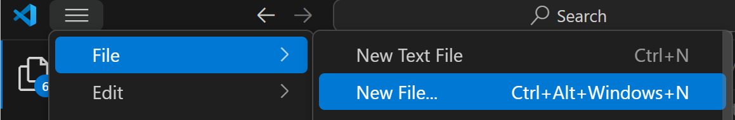
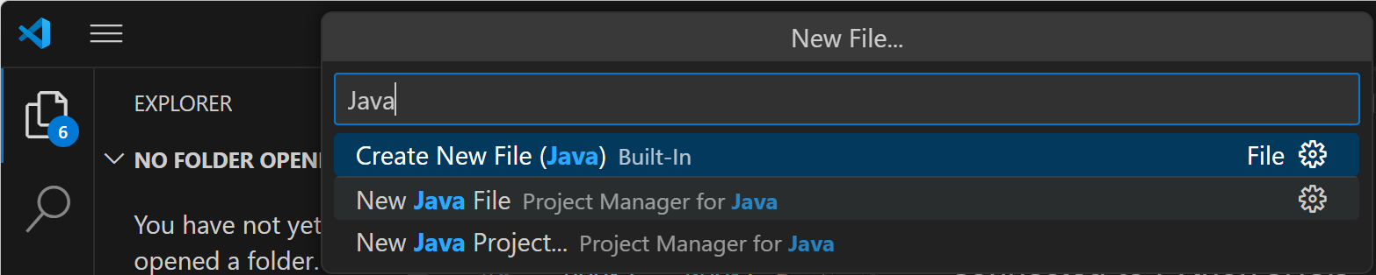
From UML Diagram to Code: Library Example (Java)

Slide 39
From UML Diagram to Code: Library Example (Java)
import java.util.ArrayList;
import java.util.List;
class Book {
String title;
String isbn;
String status = "available"; // "available" or "borrowed"
Member borrowedBy = null; // which Member has borrowed it
Book(String title, String isbn) {
this.title = title;
this.isbn = isbn;
}
}
(1, 1)
(1, M)
Library
Book
has
title
name
isbn
address
status
(0, 5)
(0, 1)
Book
Keeps the title, ISBN, whether it’s available or borrowed, and (if borrowed) which member has it.
Member
Borrowed by
id
name
email
Borrow(Book)
Return(Book)

Slide 40
From UML Diagram to Code: Library Example (Java)
class Member {
int id;
String name;
String email;
List<Book> borrowedBooks = new ArrayList<>();
Member(int id, String name, String email) {
this.id = id;
this.name = name;
this.email = email;
}
(1, 1)
(1, M)
Library
Book
has
title
name
isbn
address
status
Member
Stores id, name, email, and a list of books they currently hold.
(0, 5)
(0, 1)
Member
Borrowed by
id
name
email
Borrow(Book)
Return(Book)

Slide 41
From UML Diagram to Code: Library Example (Java)
void borrow(Book book) {
if (borrowedBooks.size() >= 5) {
System.out.println(name + " cannot borrow more than 5 books.");
return;
}
if ("borrowed".equals(book.status)) {
System.out.println("Book '" + book.title + "' is already borrowed.");
return;
}
book.status = "borrowed";
book.borrowedBy = this;
borrowedBooks.add(book);
System.out.println(name + " borrowed '" + book.title + "'.");
}
void returnBook(Book book) {
if (borrowedBooks.contains(book)) {
borrowedBooks.remove(book);
book.status = "available";
book.borrowedBy = null;
System.out.println(name + " returned '" + book.title + "'.");
} else {
System.out.println(name + " does not have '" + book.title + "'.");
}
}
}
borrow(Book)
Blocks if the member already has 5 books.
Blocks if the book is already borrowed by someone else.
Otherwise, marks the book as borrowed, remembers who borrowed it, adds it to the member’s list, and prints a message.

Slide 42
From UML Diagram to Code: Library Example (Java)
void borrow(Book book) {
if (borrowedBooks.size() >= 5) {
System.out.println(name + " cannot borrow more than 5 books.");
return;
}
if ("borrowed".equals(book.status)) {
System.out.println("Book '" + book.title + "' is already borrowed.");
return;
}
book.status = "borrowed";
book.borrowedBy = this;
borrowedBooks.add(book);
System.out.println(name + " borrowed '" + book.title + "'.");
}
void returnBook(Book book) {
if (borrowedBooks.contains(book)) {
borrowedBooks.remove(book);
book.status = "available";
book.borrowedBy = null;
System.out.println(name + " returned '" + book.title + "'.");
} else {
System.out.println(name + " does not have '" + book.title + "'.");
}
}
}
returnBook(Book)
If the member has that book, it removes it from their list, marks it available, clears the borrower, and prints a message.

Slide 43
From UML Diagram to Code: Library Example (Java)
class Library {
String name;
String address;
List<Book> books = new ArrayList<>();
Library(String name, String address) {
this.name = name;
this.address = address;
}
void addBook(Book book) {
books.add(book);
}
}
Library
Has a name, address, and a list of books, with a method to add books.

Slide 44
From UML Diagram to Code: Library Example (Java)
public class LibrarySystem_Java {
public static void main(String[] args) {
// --- Example usage (matches your Python flow) ---
Library library = new Library("Sydney Library", "123 George St");
Book book1 = new Book("Python Basics", "111");
Book book2 = new Book("Java Programming", "222");
library.addBook(book1);
library.addBook(book2);
Member member = new Member(1, "Farshid", "Farshid.Keivanian@uts.edu.au");
member.borrow(book1); // borrow success
member.borrow(book1); // already borrowed
member.returnBook(book1); // return success
}
}
main (in LibrarySystem_Java)
Creates a Library, some Books, one Member, then demo-borrows and returns.

Slide 45
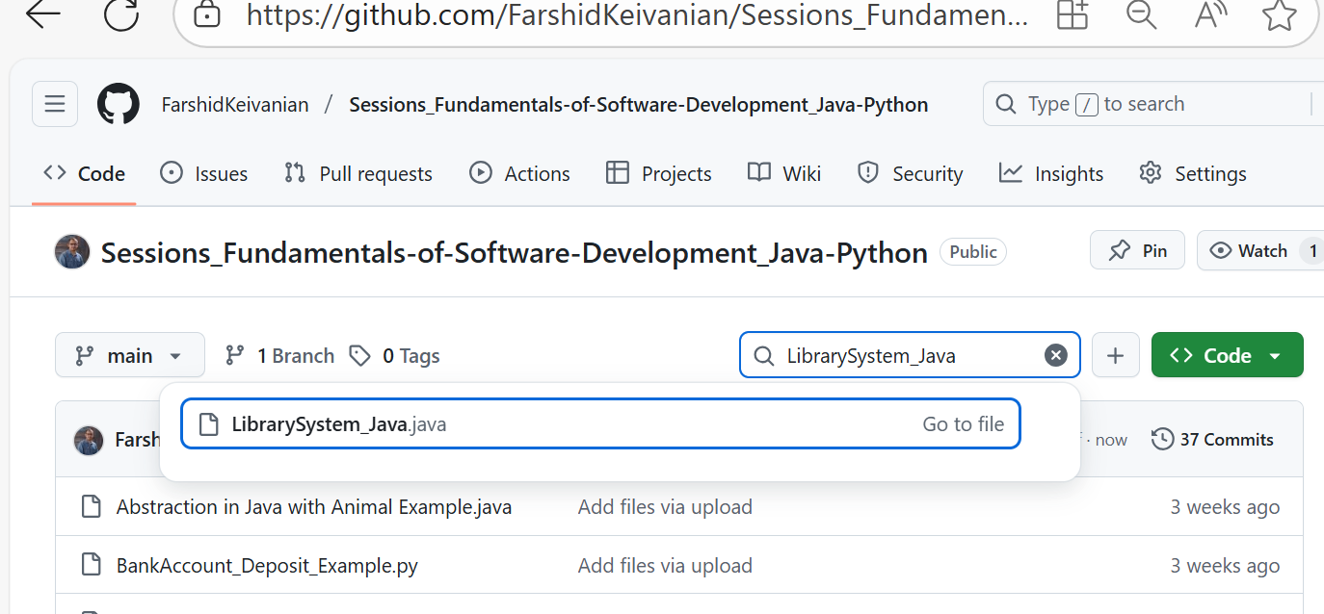
From UML Diagram to Code: Library Example (Java)
The Java code is also available on GitHub

Slide 46
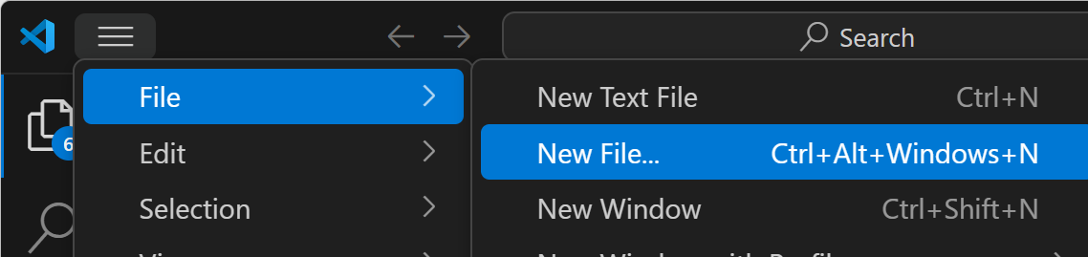
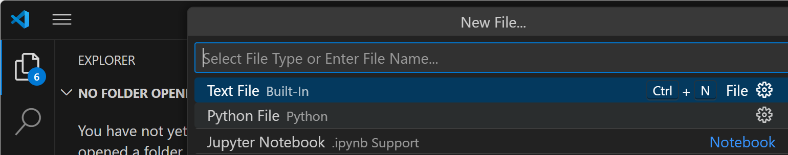
From UML Diagram to Code: Library Example (Python)

Slide 47
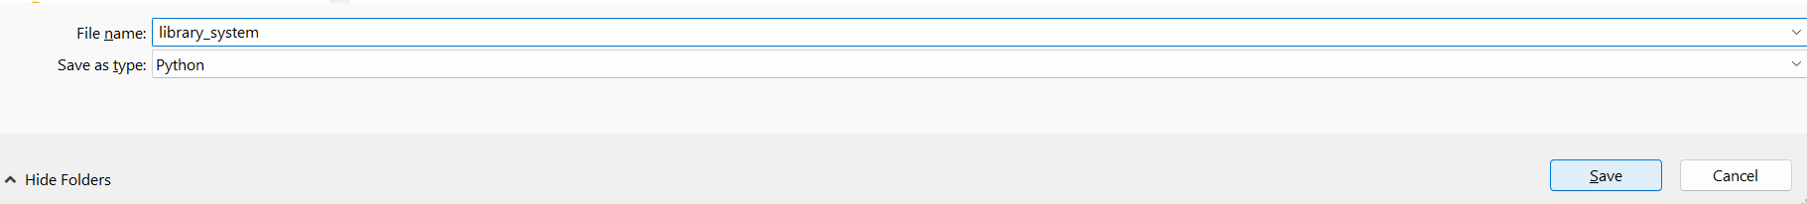
From UML Diagram to Code: Library Example (Python)
Save it as a library system:
library_system.py

Slide 48
class Book:
def __init__(self, title, isbn):
self.title = title
self.isbn = isbn
self.status = "available" # available or borrowed
self.borrowed_by = None # which Member has borrowed
(1, 1)
(1, M)
Book class
Has a title, isbn, and status (available or borrowed).
Keeps track of who borrowed it (borrowed_by).
Library
Book
has
title
name
isbn
address
status
(0, 5)
(0, 1)
Member
Borrowed by
id
name
email
Borrow(Book)
Return(Book)

Slide 49
class Member:
def __init__(self, member_id, name, email):
self.id = member_id
self.name = name
self.email = email
self.borrowed_books = []
Member class
Has an id, name, email.
Can borrow up to 5 books.
borrow(book) → checks if the member already has 5 or if the book is taken.
return_book(book) → removes the book from their list and makes it available again.
(1, 1)
(1, M)
Library
Book
has
title
name
isbn
address
status
(0, 5)
(0, 1)
Member
Borrowed by
id
name
email
Borrow(Book)
Return(Book)

Slide 50
def borrow(self, book):
if len(self.borrowed_books) >= 5:
print(f"{self.name} cannot borrow more than 5 books.")
return
if book.status == "borrowed":
print(f"Book '{book.title}' is already borrowed.")
return
book.status = "borrowed"
book.borrowed_by = self
self.borrowed_books.append(book)
print(f"{self.name} borrowed '{book.title}'.")
(1, 1)
(1, M)
Library
Book
has
title
name
isbn
address
status
(0, 5)
This method lets a member borrow a book only if they haven’t reached the 5-book limit and the book isn’t already taken.
(0, 1)
Member
Borrowed by
id
name
email
Borrow(Book)
Return(Book)

Slide 51
def borrow(self, book):
if len(self.borrowed_books) >= 5:
print(f"{self.name} cannot borrow more than 5 books.")
return
if book.status == "borrowed":
print(f"Book '{book.title}' is already borrowed.")
return
book.status = "borrowed"
book.borrowed_by = self
self.borrowed_books.append(book)
print(f"{self.name} borrowed '{book.title}'.")
(1, 1)
(1, M)
Library
Book
has
title
name
isbn
address
status
What does borrow(self, book) do?
Check limit → If the member already has 5 books, stop and show a message.
Check book status → If the book is already borrowed by someone else, stop and show a message.
Update book → Mark the book as "borrowed" and record that this member has it.
Update member → Add the book to the member’s borrowed list.
Confirm → Print a message that the member successfully borrowed the book.
(0, 5)
(0, 1)
Member
Borrowed by
id
name
email
Borrow(Book)
Return(Book)

Slide 52
def return_book(self, book):
if book in self.borrowed_books:
self.borrowed_books.remove(book)
book.status = "available"
book.borrowed_by = None
print(f"{self.name} returned '{book.title}'.")
else:
print(f"{self.name} does not have '{book.title}'.")
(1, 1)
(1, M)
What does return_book(self, book) do?
Check ownership → See if the book is in the member’s borrowed list.
If yes →
Remove the book from their list.
Mark the book as "available".
Clear who borrowed it (None).
Show a message confirming the return.
If no → Print a message saying the member never borrowed that book.
Library
Book
has
title
name
isbn
address
status
(0, 5)
(0, 1)
Member
Borrowed by
id
name
email
Borrow(Book)
Return(Book)

Slide 53
def return_book(self, book):
if book in self.borrowed_books:
self.borrowed_books.remove(book)
book.status = "available"
book.borrowed_by = None
print(f"{self.name} returned '{book.title}'.")
else:
print(f"{self.name} does not have '{book.title}'.")
(1, 1)
(1, M)
This method lets a member return a book they borrowed. If they never borrowed it, the system warns them.
Library
Book
has
title
name
isbn
address
status
(0, 5)
(0, 1)
Member
Borrowed by
id
name
email
Borrow(Book)
Return(Book)

Slide 54
class Library:
def __init__(self, name, address):
self.name = name
self.address = address
self.books = []
def add_book(self, book):
self.books.append(book)
(1, 1)
(1, M)
Library
Book
has
title
name
isbn
address
status
(0, 5)
(0, 1)
Member
Borrowed by
id
Library class
Has a name, address, and a list of books.
add_book(book) → puts new books into the library.
name
email
Borrow(Book)
Return(Book)

Slide 55
# --- Example usage ---
library = Library("Sydney Library", "123 George St")
book1 = Book("Python Basics", "111")
book2 = Book("Java Programming", "222")
library.add_book(book1)
library.add_book(book2)
member = Member(1, "Farshid Keivanian", "Farshid.Keivanian@uts.edu.au")
member.borrow(book1) # borrow success
member.borrow(book1) # already borrowed
member.return_book(book1) # return success
(1, 1)
(1, M)
Library
Book
has
title
name
isbn
address
status
(0, 5)
(0, 1)
Member
Borrowed by
Usage Example
Create a library.
Add some books.
Create a member.
Borrow and return books → see rules enforced (max 5, no double borrowing).
id
name
email
Borrow(Book)
Return(Book)

Slide 56
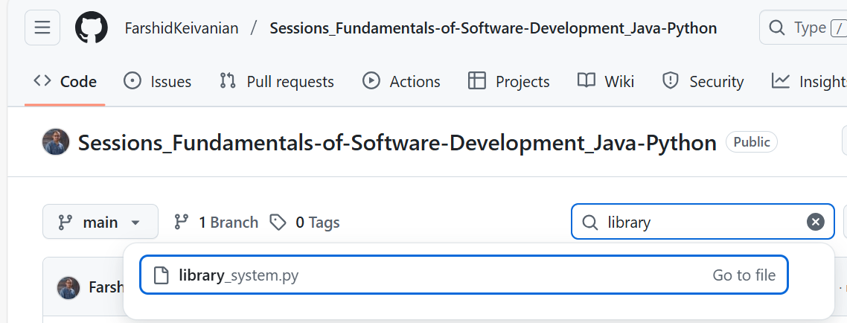
From UML Diagram to Code: Library Example (Python)
Code is also Available on GitHub (Please download it; we will have activities to extend it)
library_system.py

Slide 57
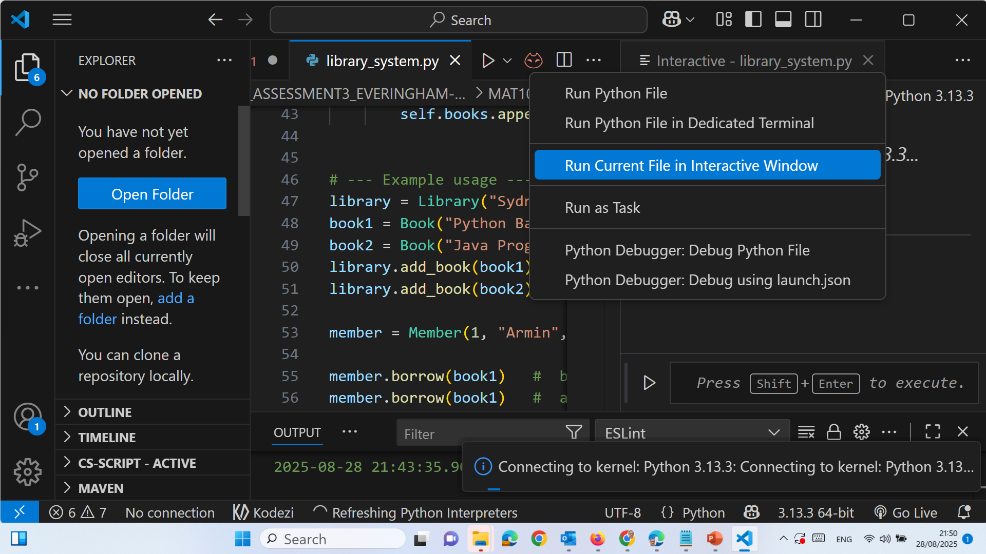
From UML Diagram to Code: Library Example (Python)

Slide 58
From UML Diagram to Code: Library Example (Python)
The Interactive Window option belongs to the Python extension + Jupyter extension in VS Code.
If you only see “Run in Terminal”, it means either:
The Jupyter extension is not installed, or
The file is not saved as .py, or
They haven’t selected the right Python interpreter / kernel.

Slide 59
From UML Diagram to Code: Library Example (Python)
Fix Steps:
Check the file extension
Save your file as something.py.
If it’s .txt or unsaved, VS Code won’t show Interactive Window.
Install the Jupyter extension
Go to the Extensions panel (Ctrl+Shift+X).
Search for “Jupyter” and install it (alongside Python extension).

Slide 60
From UML Diagram to Code: Library Example (Python)
Select Python interpreter
Press Ctrl+Shift+P → Python: Select Interpreter.
Choose the one where you installed Python (or Anaconda if using it).
Run with Interactive Window
Right-click inside the code editor → Run Current File in Interactive Window.
Or use the top-right “Run” menu.

Slide 61
From UML Diagram to Code: Library Example (Python)
In short:
If you don’t see Interactive Window, don’t panic. Save your file as .py, install the Jupyter extension, and pick the right Python interpreter. Then it will appear

Slide 62
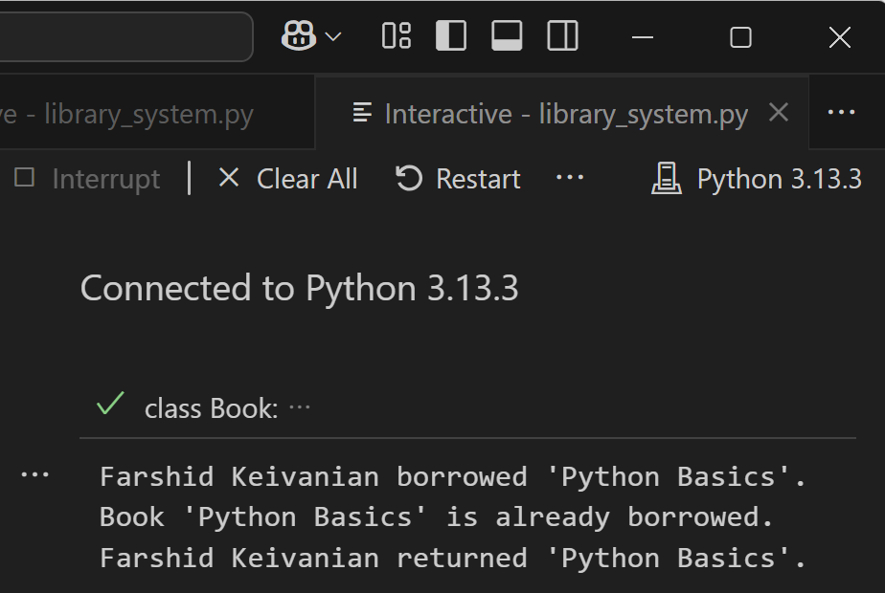
From UML Diagram to Code: Library Example (Python)
Farshid Keivanian borrowed 'Python Basics'.
The member successfully borrowed the book.
Conditions checked:
He had fewer than 5 books.
The book was available.
So the book’s status changed to borrowed, and it was added to his borrowed list.

Slide 63
From UML Diagram to Code: Library Example (Python)
Book 'Python Basics' is already borrowed.
The member tried to borrow the same book again.
The system detected the book’s status was already borrowed, so it blocked the action.

Slide 64
From UML Diagram to Code: Library Example (Python)
Farshid Keivanian returned 'Python Basics'.
The member returned the book successfully.
The book’s status changed back to available, and it was removed from his borrowed list.

Slide 65
From UML Diagram to Code: Library Example (Python)
Final State After Code Runs
Library: Still has the book.
Book ("Python Basics"): Available again (not borrowed by anyone).
Member (Farshid): Has no borrowed books.

Slide 66
From UML Diagram to Code: Library Example (Python)
In short: The code correctly enforces the borrowing rules:
Borrow once works.
Borrowing again is blocked.
Returning resets the book’s status.

Slide 67
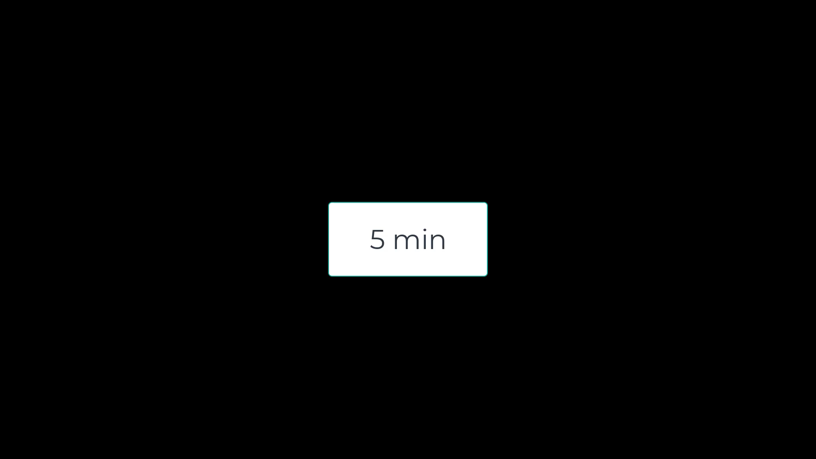
Activity 1 — Show the current count when limit blocks borrowing
Task: When a member hits the 5-book limit, show how many they already have. Hint for Python: Edit the first print(...) inside Member.borrow() where the limit is checked.
Hint for Java: Inside Member.borrow() in the limit check.

Slide 68
Activity 1 — Show the current count when limit blocks borrowing
print(f"{self.name} cannot borrow more than 5 books (currently {len(self.borrowed_books)}/5).")
For Python
len(self.borrowed_books) → this calculates the length of the list self.borrowed_books.
In other words, it counts how many books the member has borrowed right now.
Example: if the list has 3 books, then len(self.borrowed_books) = 3. Then the code prints it as: (currently 3/5) → which means 3 books out of the 5 allowed.

Slide 69
Activity 1 — Show the current count when limit blocks borrowing
(Java) Line 30:
if (borrowedBooks.size() >= 5) {
System.out.println(name + " cannot borrow more than 5 books.");
return;
}
System.out.println(name + " cannot borrow more than 5 books. You already have "
+ borrowedBooks.size() + " book(s).");

Slide 70
Activity 2 — Show total borrowed after a successful borrow
Task: After borrowing succeeds, print how many books the member now has. Hint for Python: Edit the last print(...) in Member.borrow() Class Member >> borrow method (success branch).
Hint for Java: At the end of the success branch in Member.borrow() (after borrowedBooks.add(book);).

Slide 71
Activity 2 — Show total borrowed after a successful borrow
print(f"{self.name} borrowed '{book.title}' (now {len(self.borrowed_books)} borrowed).")
This line prints a message when a member borrows a book.
{self.name} → shows the member’s name.
{book.title} → shows the book’s title.
{len(self.borrowed_books)} → counts how many books the member has borrowed so far.
In short: It tells who borrowed what book and how many books they now hold.

Slide 72
Activity 2 — Show total borrowed after a successful borrow
(Java) Line 41 of modified version:
System.out.println(name + " borrowed '" + book.title + "'.");
System.out.println(name + " borrowed '" + book.title + "'. Now holding "
+ borrowedBooks.size() + " book(s).");

Slide 73
Activity 3 — Show remaining count after a successful return
Task: After a return, display how many books the member still holds. Hint for Python: Edit the success print(...) inside Member.return_book(), where the if condition is true.
Hint for Java: Inside Member.returnBook() in the success part (inside the if (borrowedBooks.contains(book)) block), after you remove the book.

Slide 74
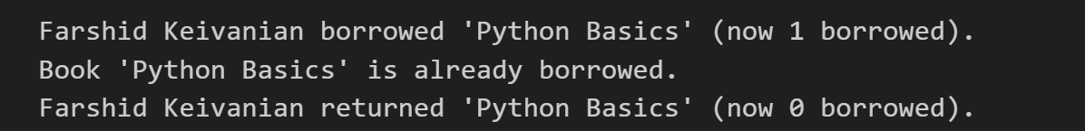
Activity 3 — Show remaining count after a successful return
print(f"{self.name} returned '{book.title}' (now {len(self.borrowed_books)} borrowed).")
(Python) When a member returns a book, this line prints:
Who returned it (self.name).
Which book was returned (book.title).
How many books they still have after the return (len(self.borrowed_books)).
Suppose Farshid had 3 books and returned Python Basics. It will print Farshid returned 'Python Basics' (now 2 borrowed).
Before return → 3 borrowed.
After return → 2 borrowed.

Slide 75
Activity 3 — Show remaining count after a successful return
(Java) Line 50 of modified version:
System.out.println(name + " returned '" + book.title + "'.");
System.out.println(name + " returned '" + book.title + "'. Now holding " + borrowedBooks.size() + " book(s).");
Note: borrowedBooks.size() already reflects the decreased count after remove(book).

Slide 76
Activity 4 — Track how many times a book has ever been borrowed
Task: Keep a running counter times_borrowed on each Book. Hint for Python: Add one new line in Member.borrow() right after setting book.borrowed_by = self (line 23), then display it
Hint for Java: Step 1 (new field): Add this inside class Book with the other fields (line 9).
int timesBorrowed = 0; // how many times this book has been borrowed (lifetime)
Step 2 (increment): In Member.borrow() after you mark the book borrowed and set the borrower, increment the counter.

Slide 77
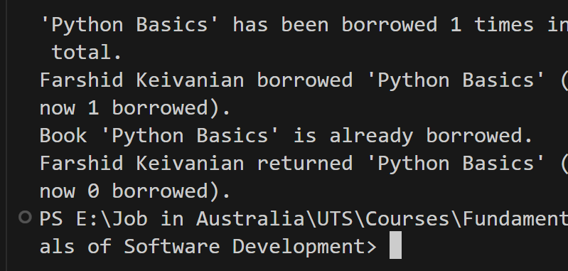
Activity 4 — Track how many times a book has ever been borrowed
book.times_borrowed = getattr(book, "times_borrowed", 0) + 1
print(f"'{book.title}' has been borrowed {book.times_borrowed} times in total.") # NEW line
(Python) If Farshid borrows Python Basics twice (with return in between):
Farshid borrowed 'Python Basics' (now 1 borrowed). 'Python Basics' has been borrowed 1 times in total. Farshid returned 'Python Basics' (now 0 borrowed). Farshid borrowed 'Python Basics' (now 1 borrowed). 'Python Basics' has been borrowed 2 times in total.

Slide 78
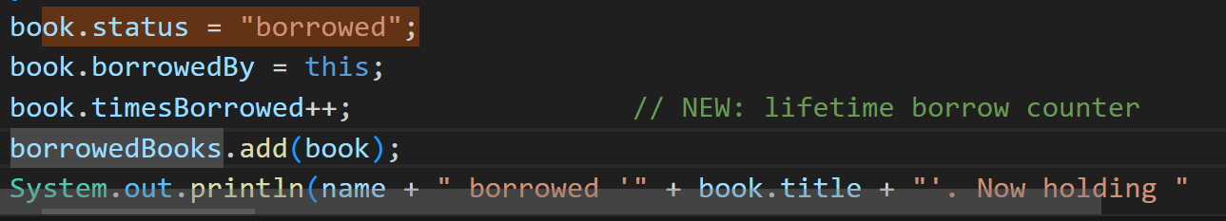
Activity 4 — Track how many times a book has ever been borrowed
(Java) line 9
int timesBorrowed = 0; // how many times this book has been borrowed (lifetime)
Class Member >> borrow – line 39
book.status = "borrowed";
book.borrowedBy = this;
borrowedBooks.add(book);

Slide 79
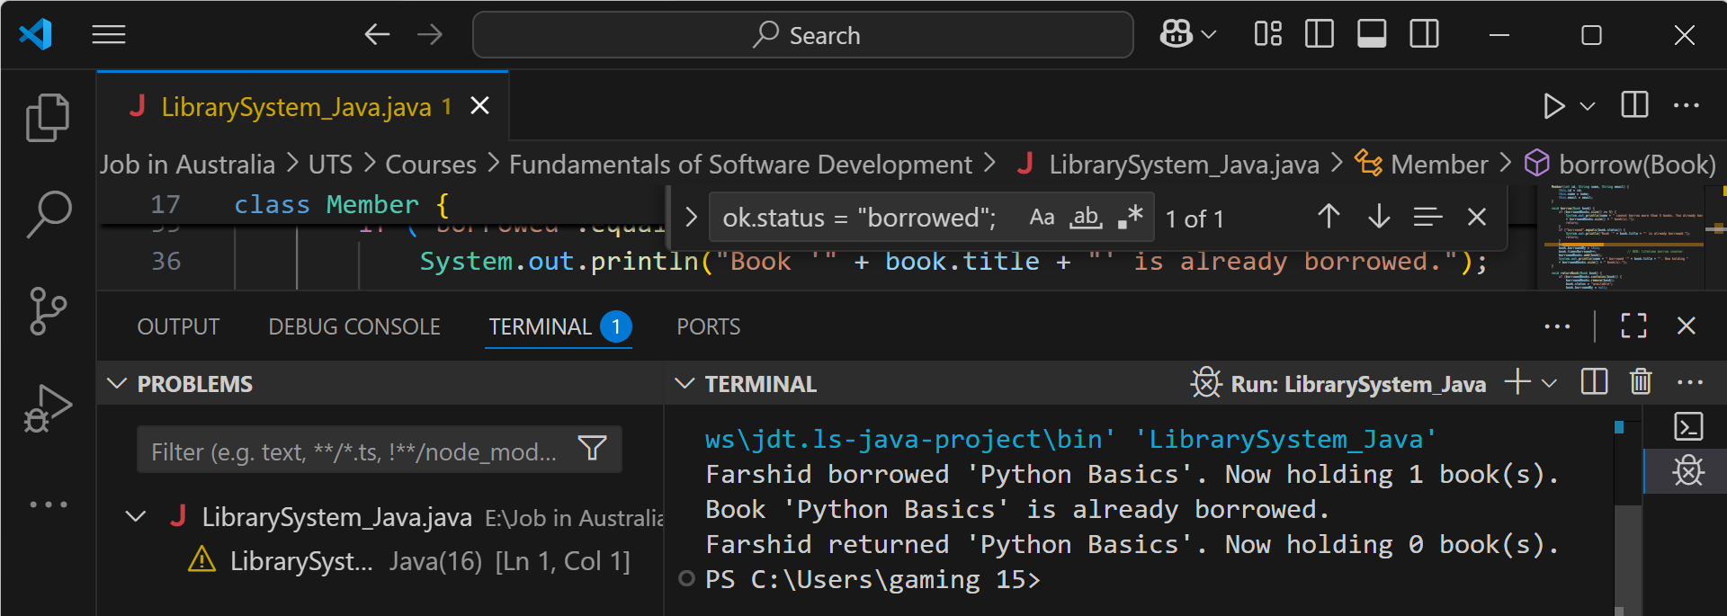
First borrow
borrow(book1) passed both checks (limit < 5, book available).
State changes:
book1.status = "borrowed"
book1.borrowedBy = Farshid
member.borrowedBooks.size() → 1
We see the Activity-2 message: “Now holding 1 book(s).”

Slide 80
Second borrow (same book)
if ("borrowed".equals(book.status)) triggered.
No state changes (book already with Farshid).
Correct error line printed: “Book 'Python Basics' is already borrowed.”

Slide 81
Return
returnBook(book1) found the book in borrowedBooks, removed it.
State changes:
book1.status = "available"
book1.borrowedBy = null
member.borrowedBooks.size() → 0
You see the Activity-3 message: “Now holding 0 book(s).”

Slide 82
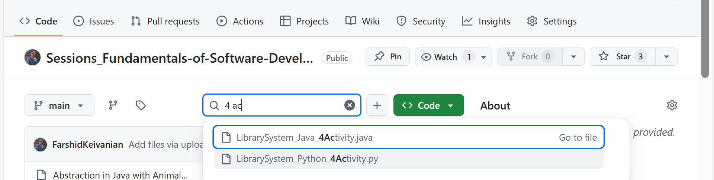
Activity 5 — Show who already has the book
First, download the complete file from GitHub and Apply these changes
Python and Java File Available on GitHub (With 4 Activities)

Slide 83
Activity 5 — Show who already has the book
Task: If borrowing is blocked because the book is taken, show the current borrower’s name.
Python — Hint: In Member.borrow(), in the if book.status == "borrowed": block, replace the print line.
print(f"Book '{book.title}' is already borrowed by {book.borrowed_by.name}.")
Java — Hint: In Member.borrow(), inside if ("borrowed".equals(book.status)) { ... }, replace the println.
System.out.println("Book '" + book.title + "' is already borrowed by " + book.borrowedBy.name + ".");

Slide 84
Activity 6 — Show remaining slots after a successful borrow
Task: After a successful borrow, also show how many slots remain (5 − current).
Python — Hint: In Member.borrow(), replace the success print(...) at the end of the success path.
print(f"{self.name} borrowed '{book.title}' (now {len(self.borrowed_books)}/5; {5 - len(self.borrowed_books)} left). This book has been borrowed {book.times_borrowed} time(s) in total.")
Java — Hint: In Member.borrow(), replace the success System.out.println(...) after borrowedBooks.add(book).
System.out.println(name + " borrowed '" + book.title + "' (now " + borrowedBooks.size() + "/5; " + (5 - borrowedBooks.size()) + " left). This book has been borrowed " + book.timesBorrowed + " time(s) in total.");

Slide 85
Activity 7 — When returning a book you don’t have, show who actually has it
Task: If the member tries to return a book they don’t hold, show the current holder (or “nobody”).
Python — Hint: In Member.return_book(), in the else: branch, replace the print line.
print(f"{self.name} does not have '{book.title}'. Currently with {book.borrowed_by.name if book.borrowed_by else 'nobody'}.")
Java — Hint: In Member.returnBook(), in the else branch, replace the println.
System.out.println(name + " does not have '" + book.title + "'. Currently with " + (book.borrowedBy != null ? book.borrowedBy.name : "nobody") + ".");

Slide 86
Activity 8 — Simple email sanity check on member creation
Task: Warn if the email looks invalid (no “@”).
Python — Hint: In Member.__init__, at the end of the constructor, add one line.
if "@" not in self.email: print(f"Warning: '{self.email}' may be invalid.")
Java — Hint: In Member constructor, at the end of the constructor, add one line.
if (!this.email.contains("@")) System.out.println("Warning: '" + this.email + "' may be invalid.");

Slide 87
Activity 9 — Tidy book titles on creation
Task: Normalise book titles when creating a Book (nice capitalisation).
Python — Hint: In Book.__init__, replace self.title = title.
self.title = title.title()
Java — Hint: In Book constructor, replace this.title = title;.
this.title = title.isEmpty() ? title : Character.toUpperCase(title.charAt(0)) + title.substring(1);

Slide 88
Activity 10 — Warn on duplicate ISBN when adding to the library
Task: If a book with the same ISBN already exists in the library, print a warning (still add it).
Python — Hint: In Library.add_book(), at the very top of the method, add one line.
if any(b.isbn == book.isbn for b in self.books): print(f"Warning: ISBN {book.isbn} already exists.")
Java — Hint: In Library.addBook(Book book), at the very top of the method, add one line.
if (books.stream().anyMatch(b -> b.isbn.equals(book.isbn))) System.out.println("Warning: ISBN " + book.isbn + " already exists.");

Slide 89

Happy Learning and Bright Futures Ahead! Dr. Farshid Keivanian Stay Connected: linkedin.com/in/farshid-keivanian github.com/FarshidKeivanian
Education is the most powerful weapon you can use to change the world. — Nelson Mandela

